Slide 1
Angular 2
One framework.
Mobile & Desktop
Angular open-source font-end JavaScript framework hai. jis par browser based application bana sakate hai

Slide 2
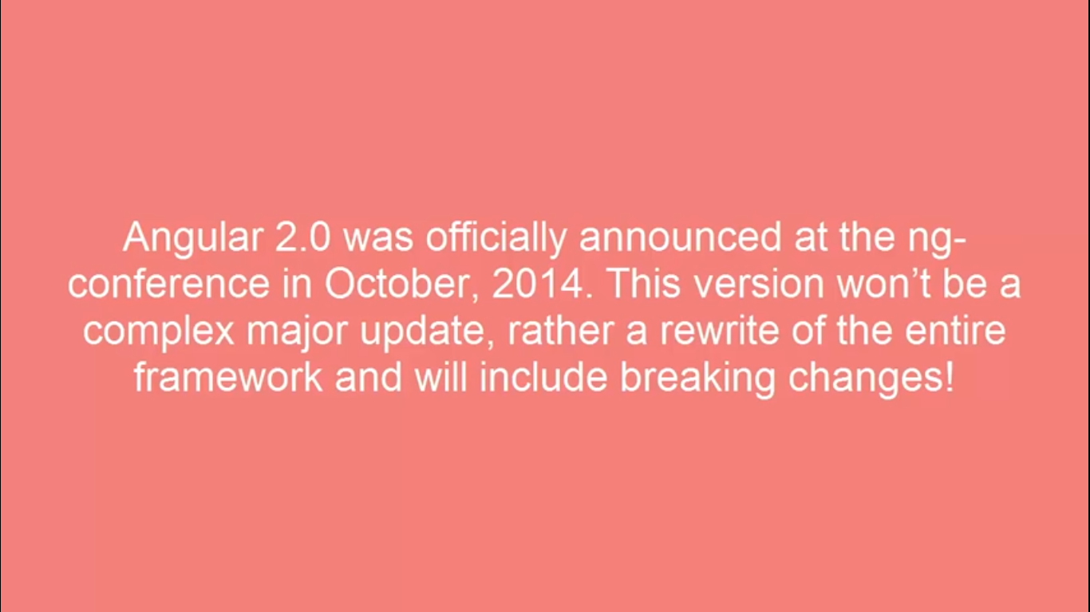

Slide 3
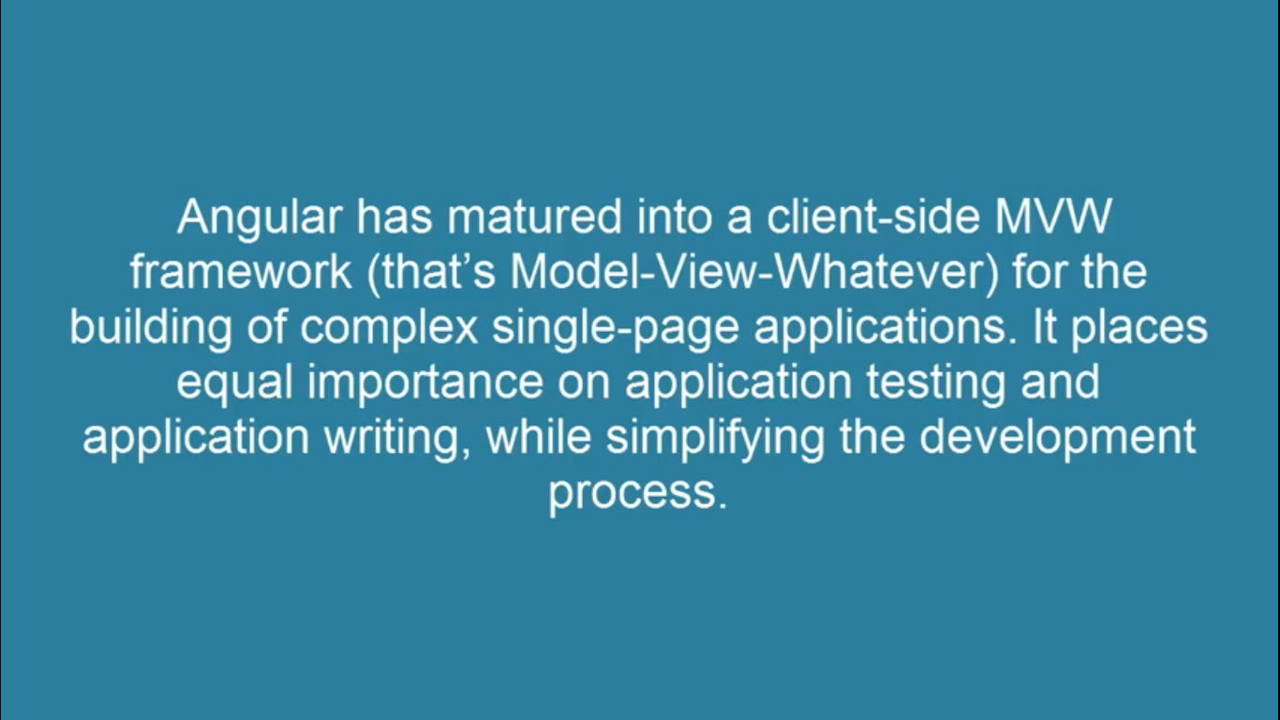
MVW

Slide 4


Slide 5
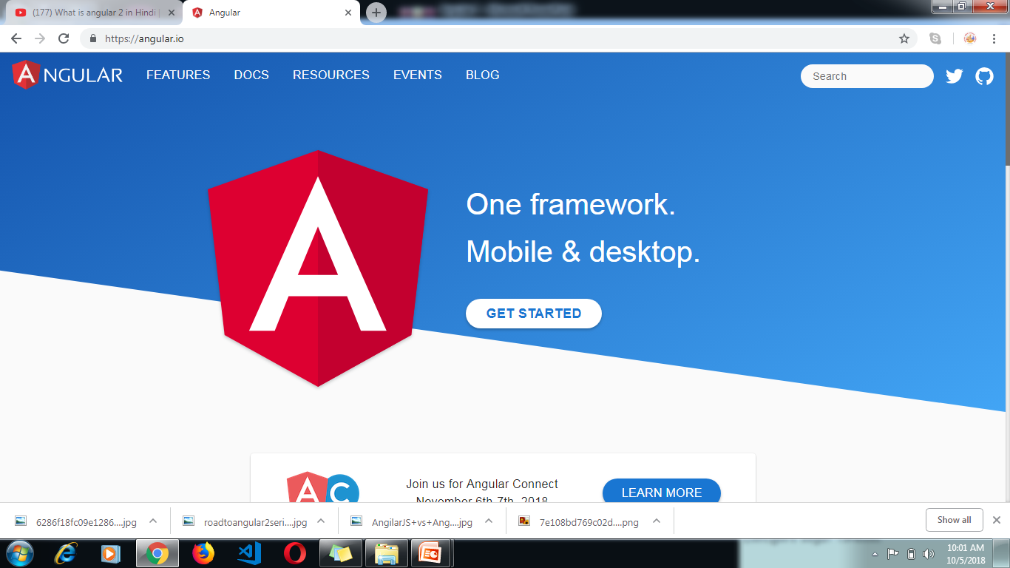
https://angular.io/

Slide 6
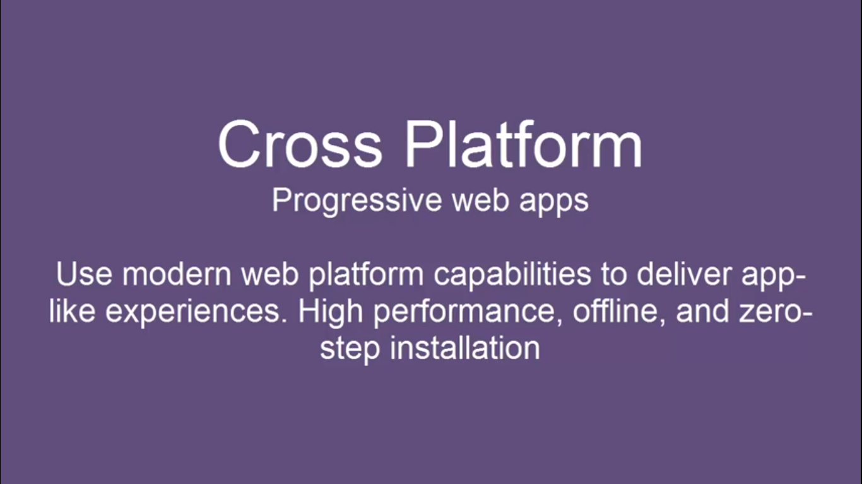

Slide 7
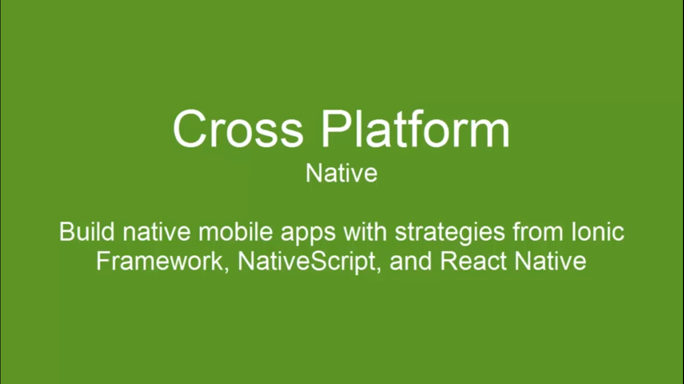

Slide 8
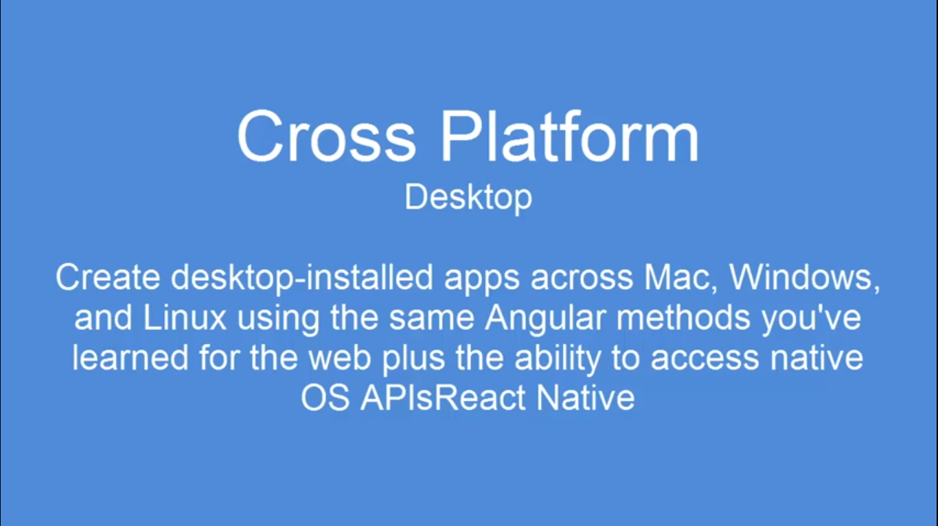

Slide 9
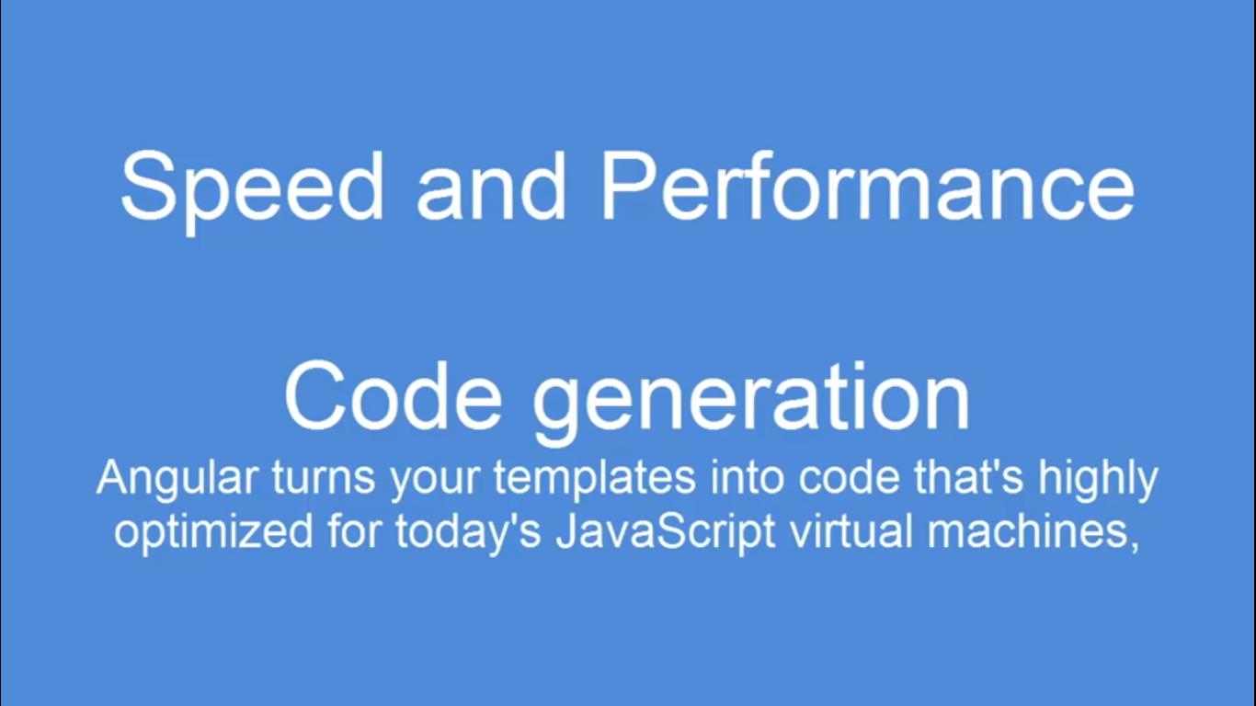

Slide 10
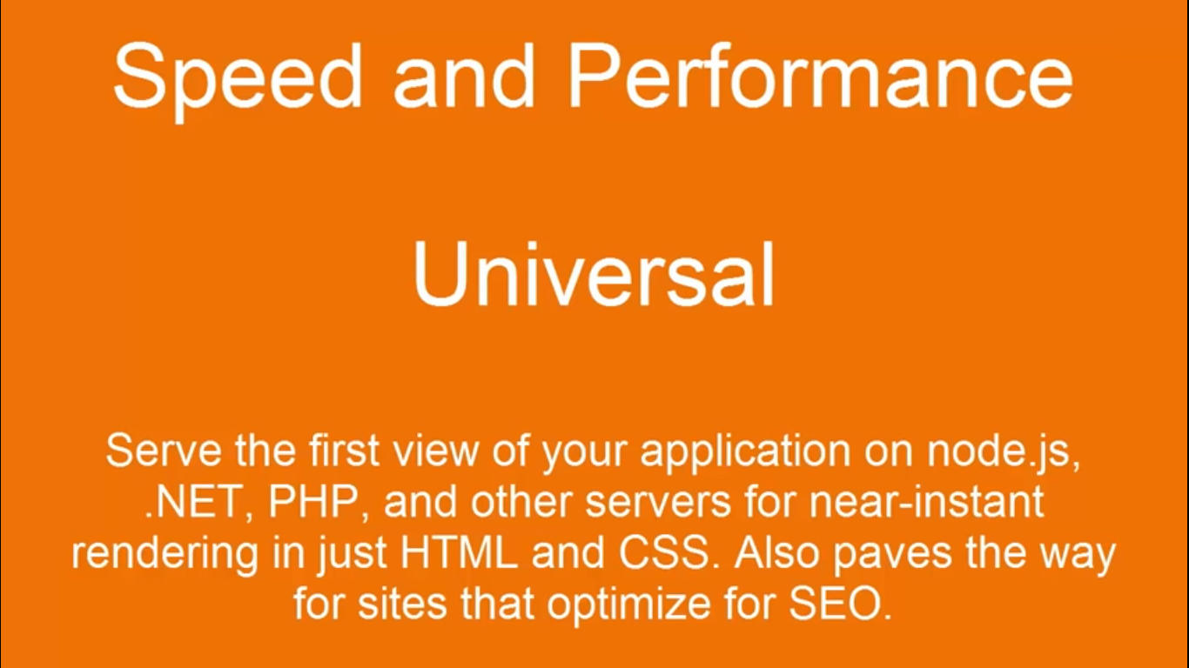

Slide 11
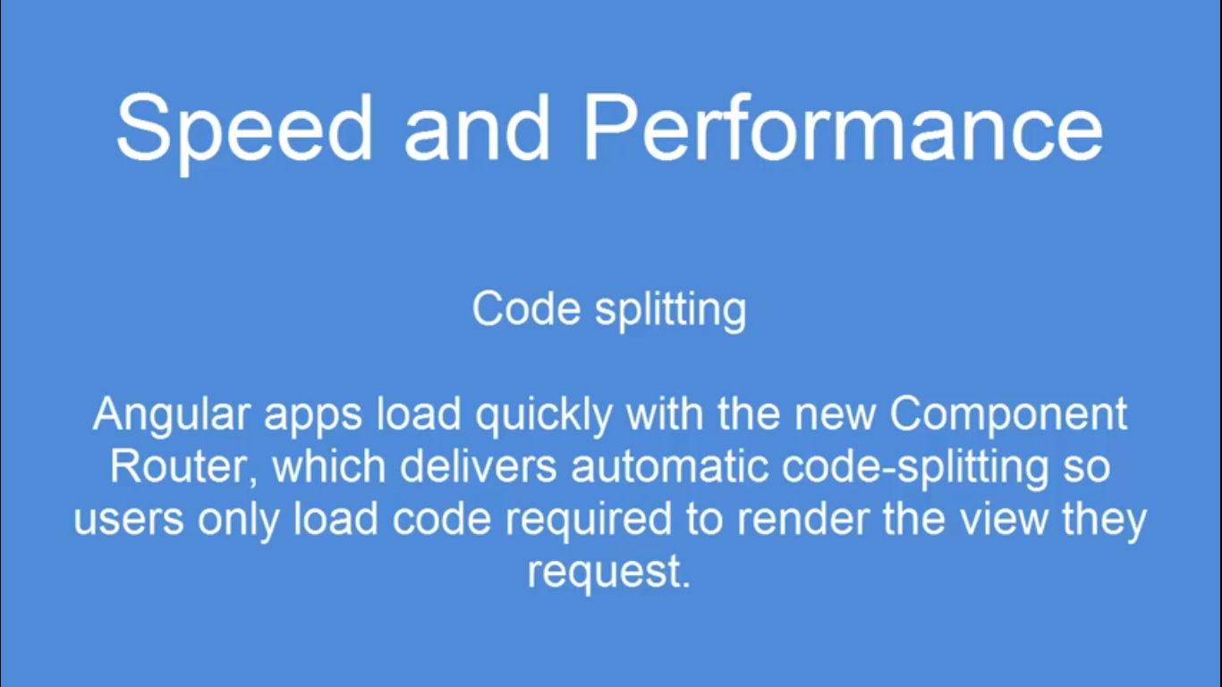

Slide 12
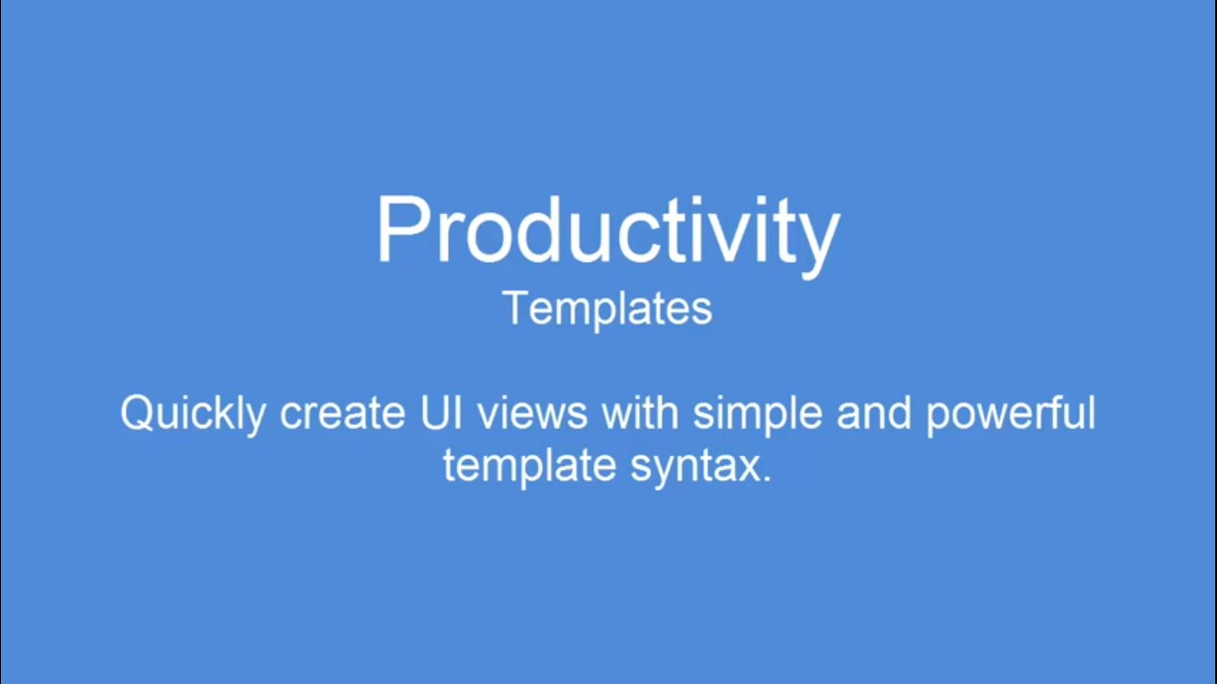

Slide 13
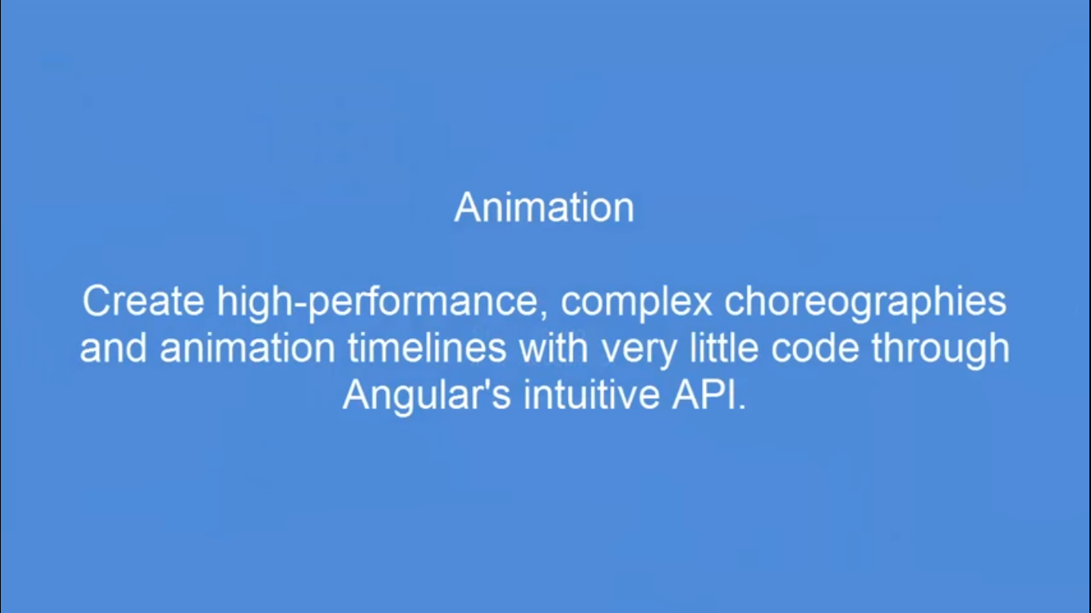

Slide 14
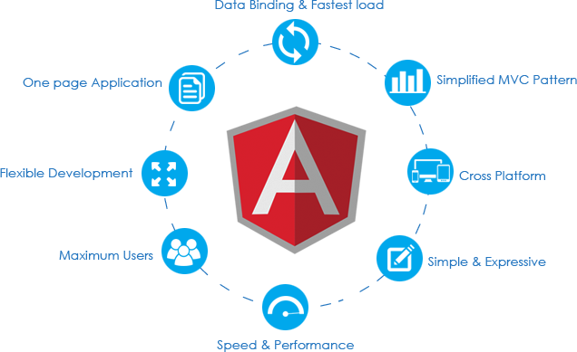

Slide 15
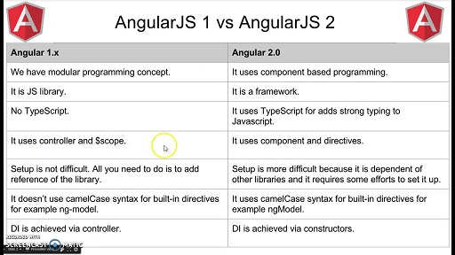

Slide 16
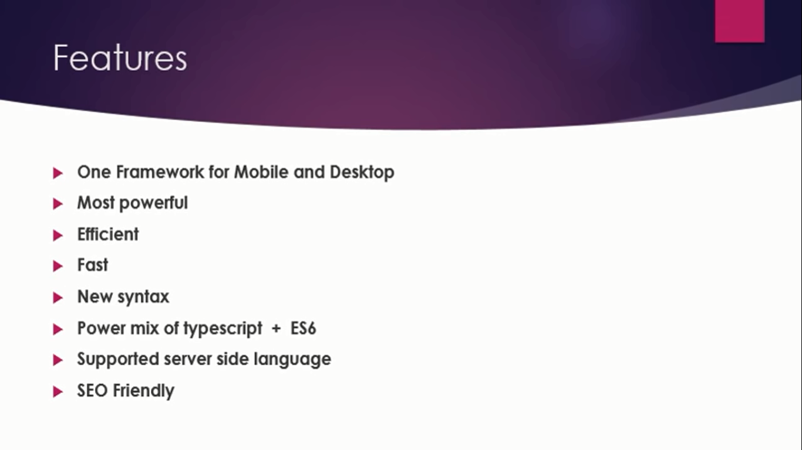

Slide 17
There are basically 8 building Blocks of Angular
Modules
Components
Templates
Metadata
Data Binding
Directives
Services
Dependency Injection

Slide 18
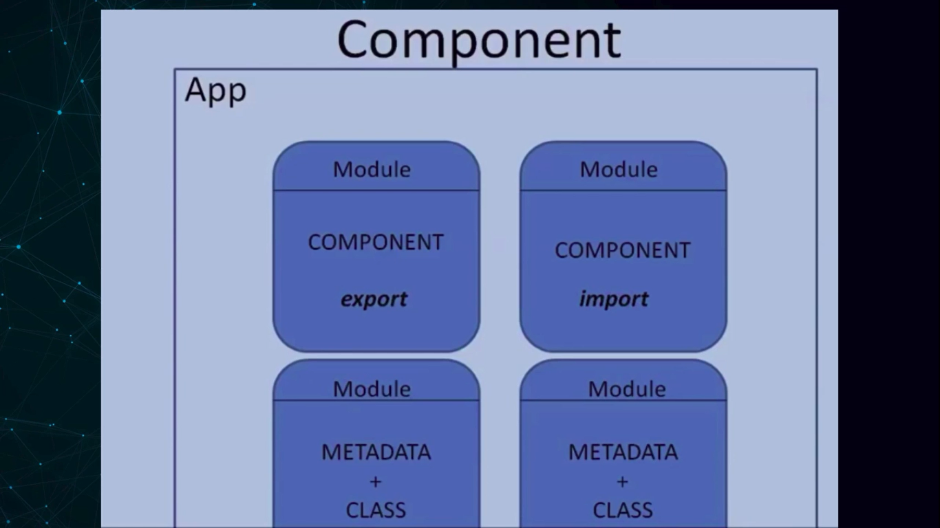

Slide 19
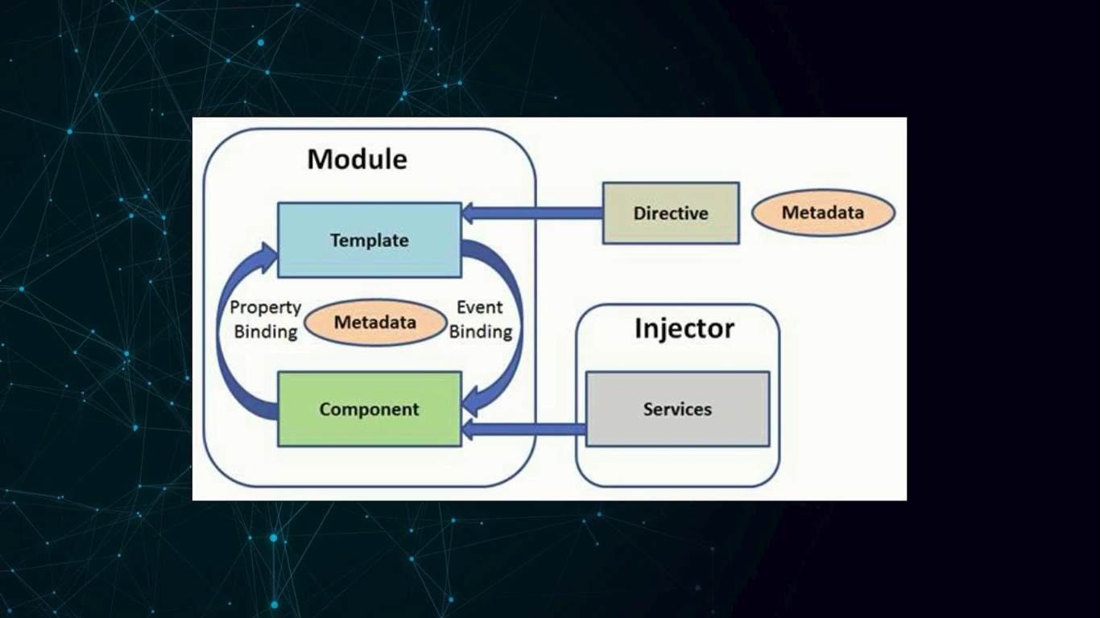

Slide 20
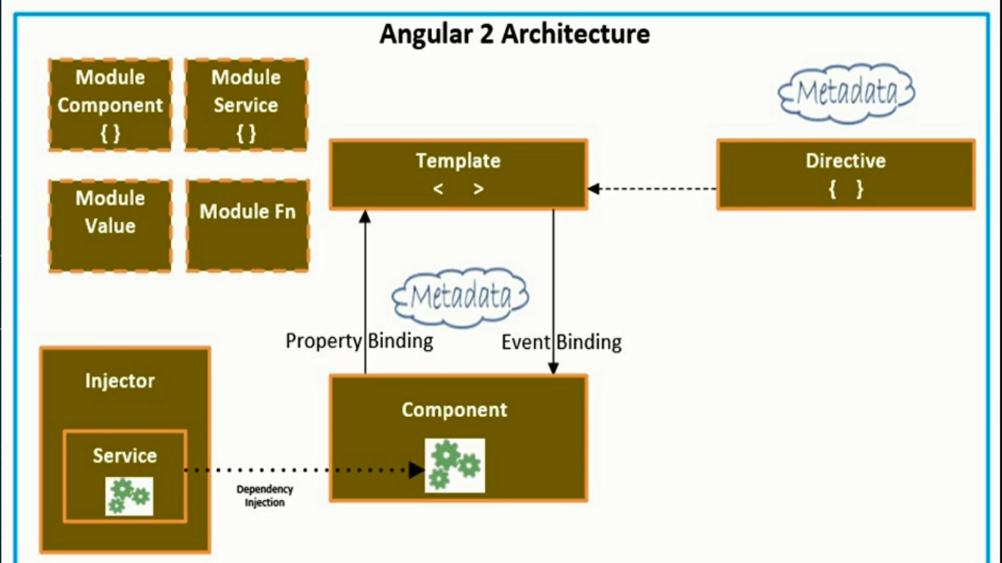

Slide 21
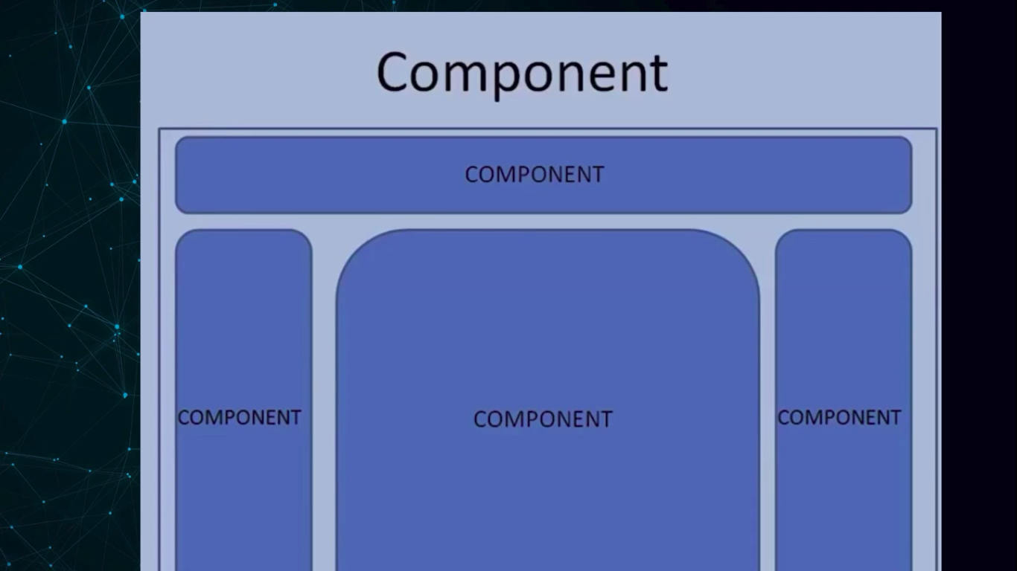

Slide 22
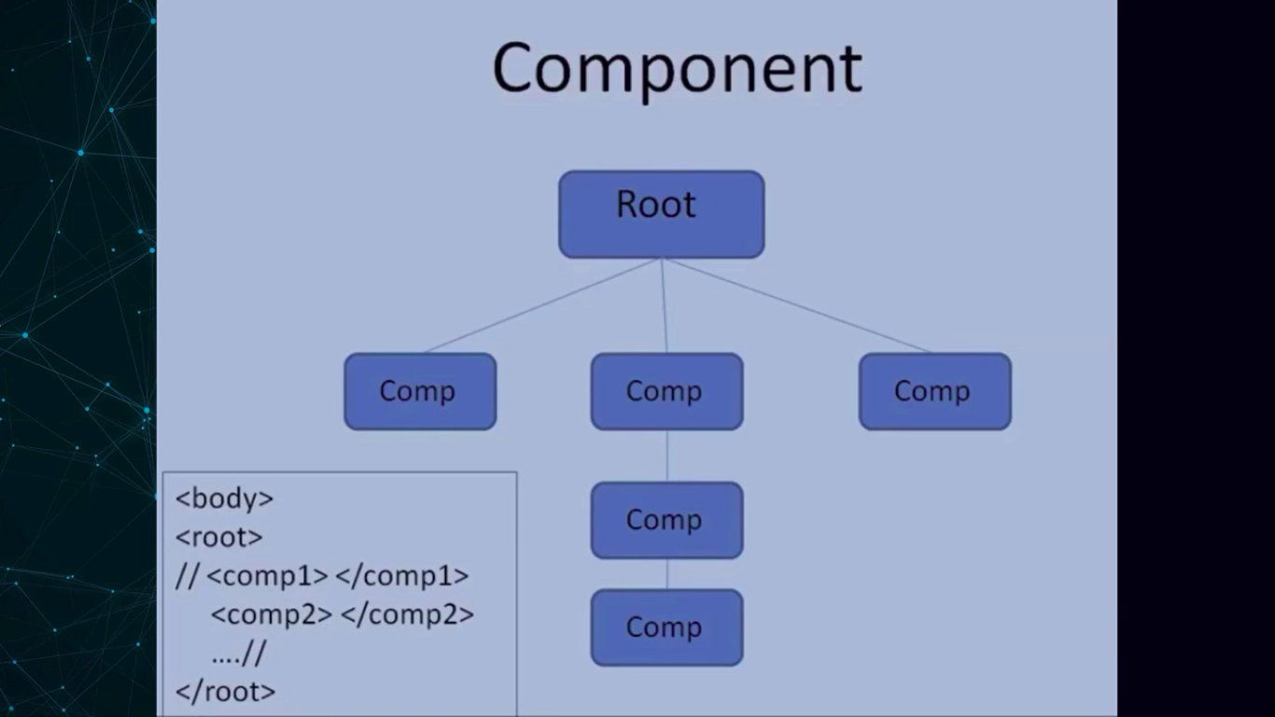

Slide 23
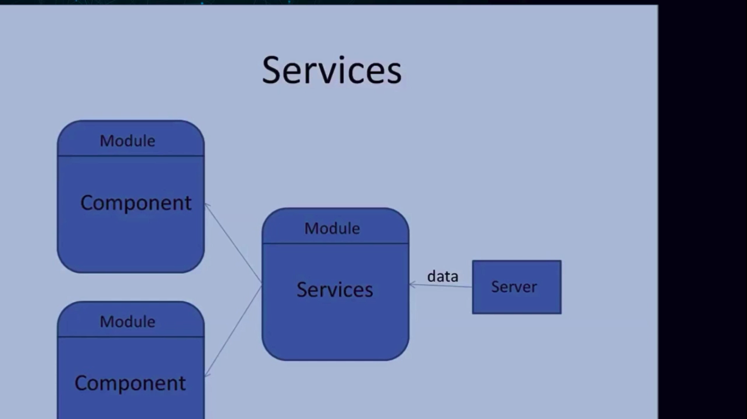

Slide 24
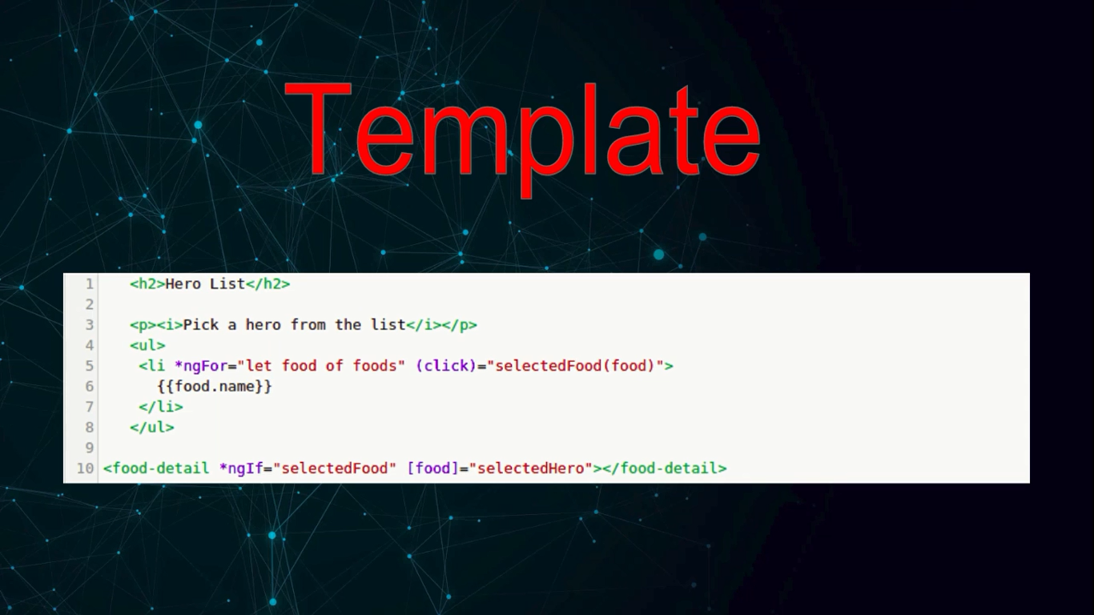

Slide 25
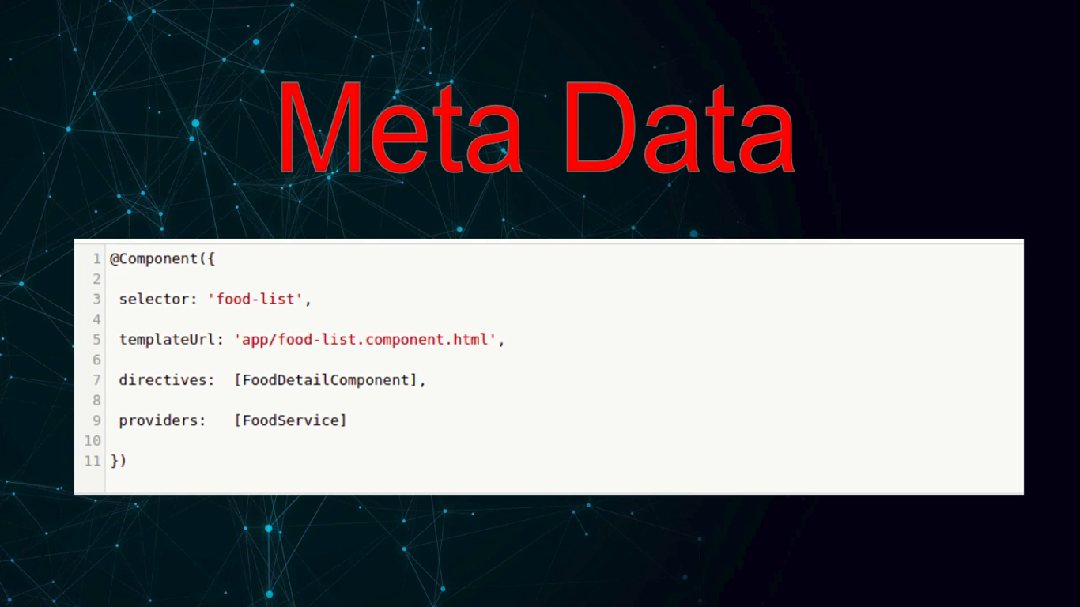

Slide 26
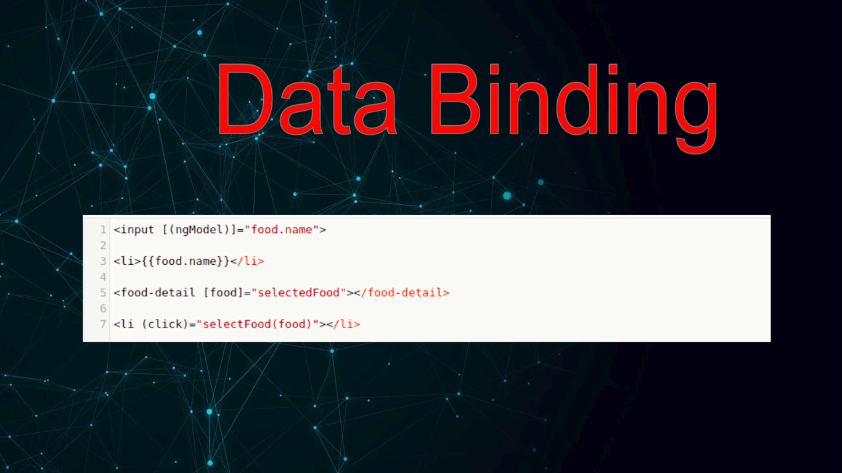

Slide 27
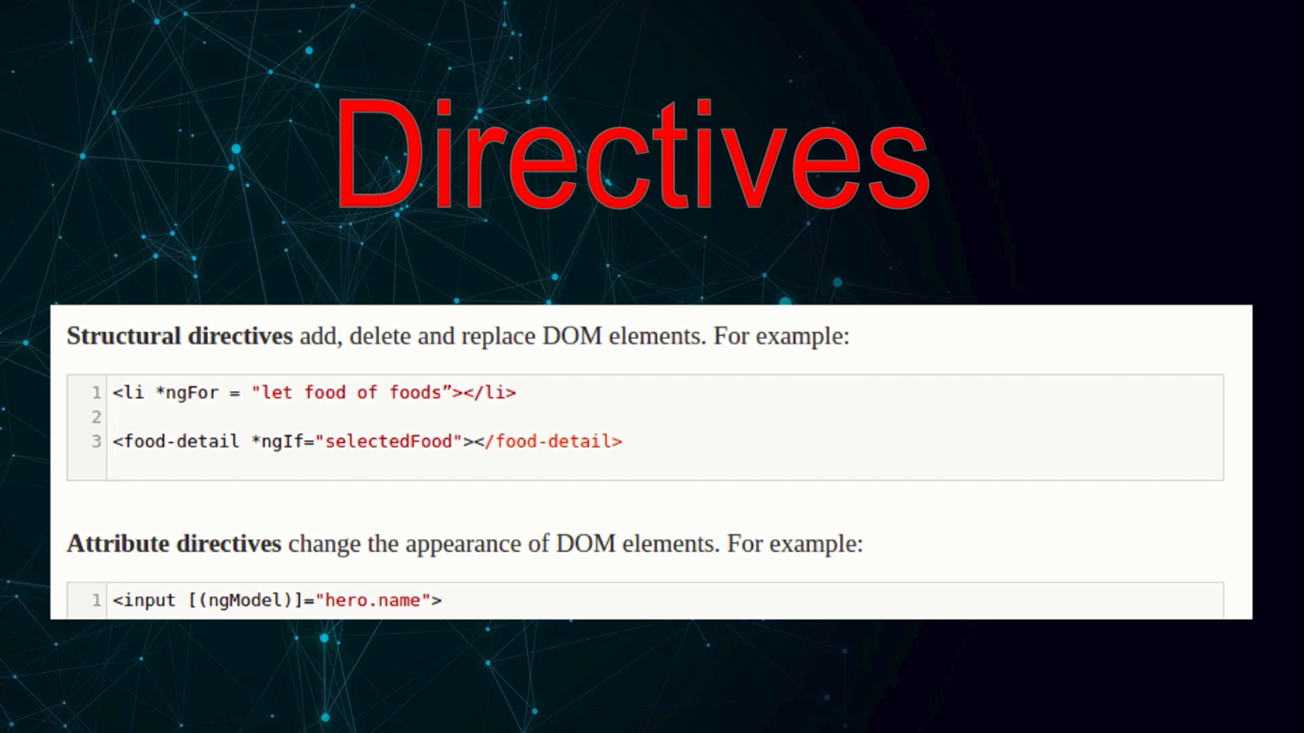

Slide 28
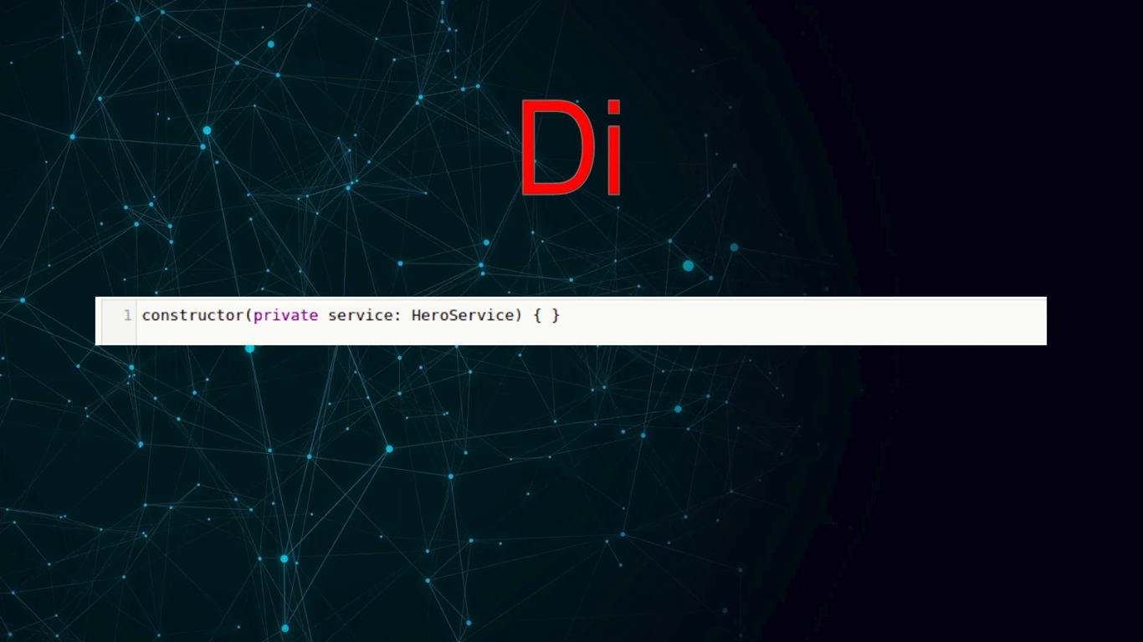

Slide 29
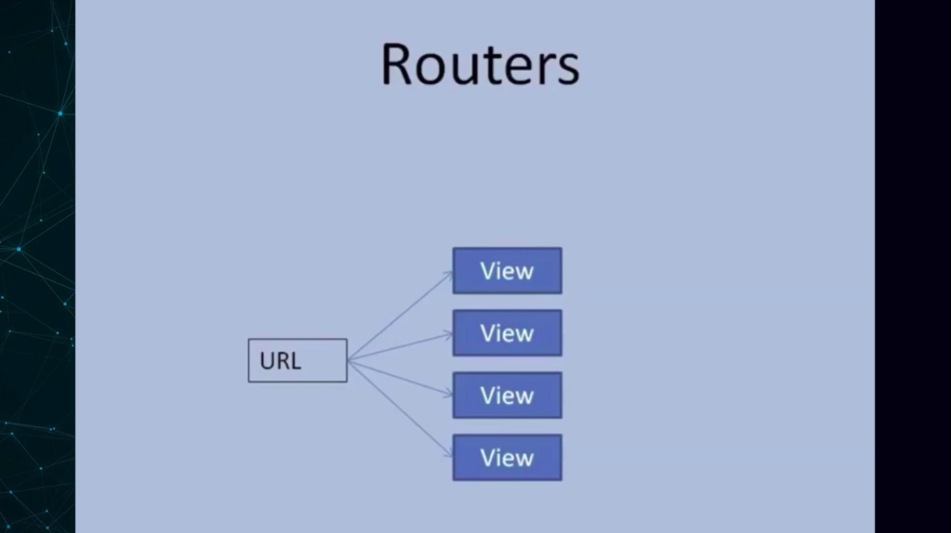

Slide 30
Install Angular CLI (command line interface) 2
Node –v
Npm –v
ng serve
Node js- sever side language. is ke package manager ko use karane ke liye kiya karna hai .or angular CLI use karne ke liye karna h..
Package manager ka use is liye karate h taki project mai use hone bali depen dence une h hum support kar sake locally.
VSCODE (OPEN SOURCE IDE HAI MICROSOFT PROVIDE BEST SUPPORT FOR TYPESCRIPT)

